Slide 1

Get parked’s parking spot detection system set up tutorial
Detection code by: Get Parked
Set up tutorial for Get Parked’s detection code. This tutorial aims to teach how to set up the detecting tools of this parking spot detection program, these tools include region defining, color value for comparison defining and tuning, filtering by: minimum area of green pixels, rectangularity of green pixel regions and percentage of green pixels in a defined region.
This tutorial is the following step after downloading the main python file and the support file.
Code files and virtual environment access at the end of this document.

Slide 2

1 - Load Image, resize and copy
After the function definition section on the main file (‘Final Pi 4.py’) a section to load the image will follow, make sure the address inside the brackets and apostrophes corresponds to the image you desire to process.
In case your main file is in the same folder as your desired picture, you would only have to type the name of the file and its extension.
Everything else should remain the same.

Slide 3
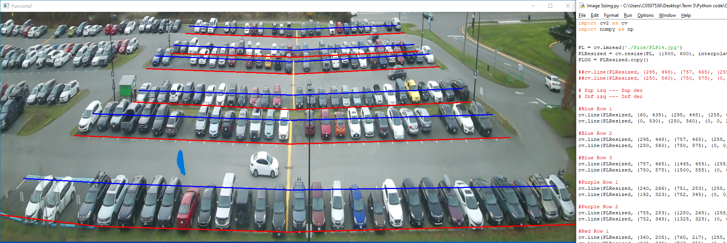
2 - Define regions of interest
Using the support file (‘Image Sizing’) and the ‘Draw-Line’ command, set regions of interest in form of 4 (x, y) coordinates defining a polygon, you can define as much regions as you desire.
This regions will be the only ones that the program will process.
These are pixel coordinates, the left upper corner is the point (0, 0). Take note of the file dimensions of the image.

Slide 4
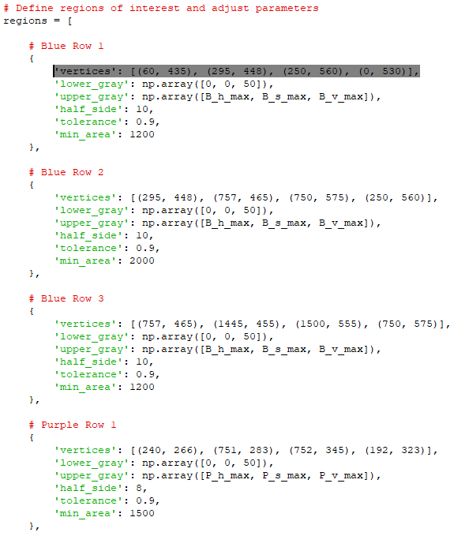
2 - Define regions of interest
Write on the regions section of the code the coordinates of the defined regions, note the order in which you type the vertices, the order goes from left to right: Left Upper Corner, Right Upper Corner, Right Lower Corner, Left Lower Corner.

Slide 5
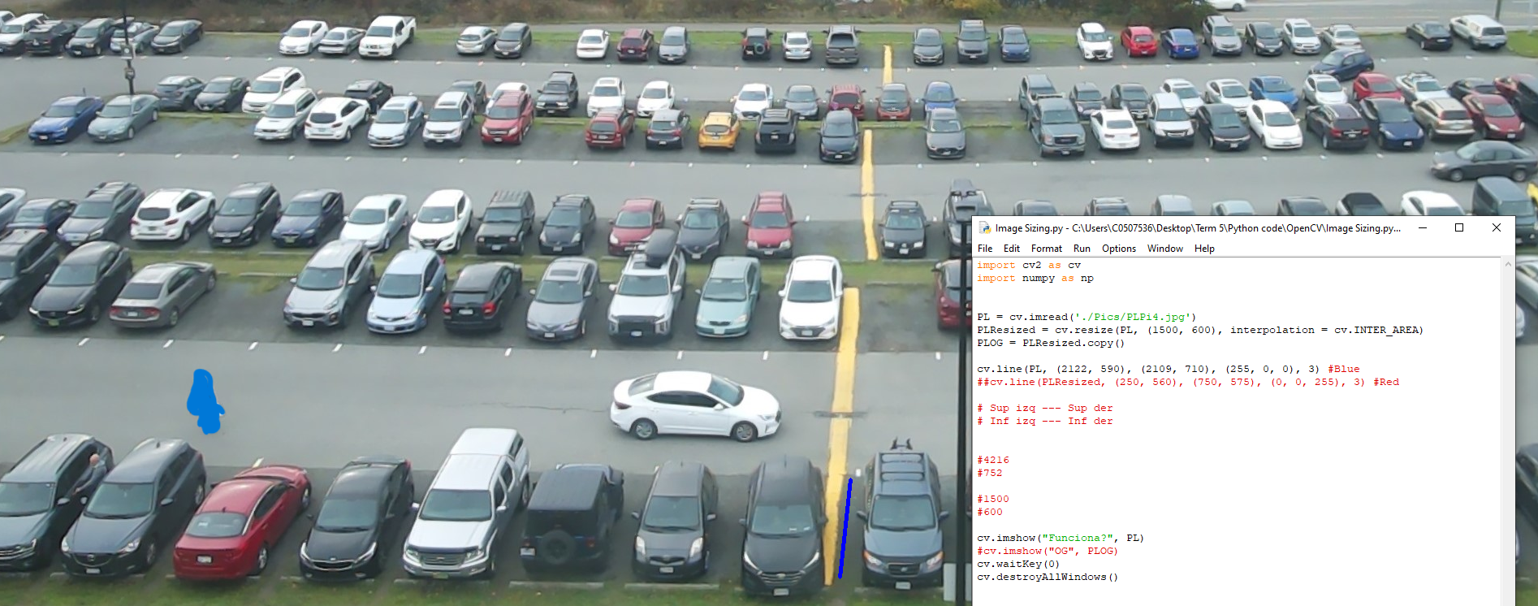
3 – Setting Up line for HSV pulling
On the support file, make sure that you modify the code such that on the line ‘cv.line(PLResized, (….)’ you modify ‘PLResized’ to only ‘PL’. Do the same for the ‘cv.imshow("Funciona?", PLResized)’. The resultant code should appear on the image.
Define a line on the image that only covers parking stall ground and does not interfere with any other object in the image, consider that nothing should ever overlap the stall ground on this image.
The code will pull the HSV values of this line and compare by colour each pixel on the image to find similar pixels to the ones on the line.

Slide 6

3 – Setting Up line for HSV pulling
You can set different lines for the HSV colour pulling, this will depends on the parking lot characteristics.

Slide 7
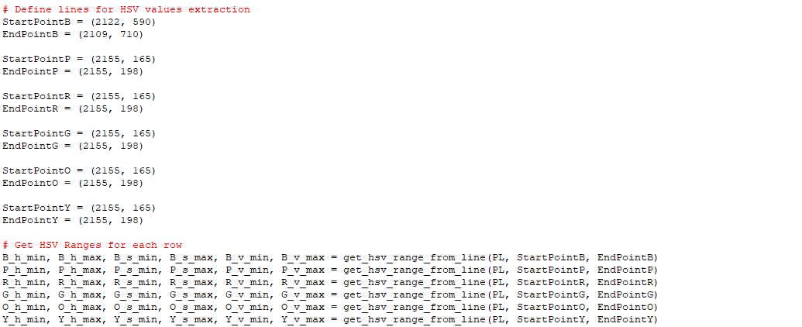
3 – Setting Up line for HSV pulling
Save these coordinates on the corresponding section of the code, you can use the same coordinates for different regions.

Slide 8
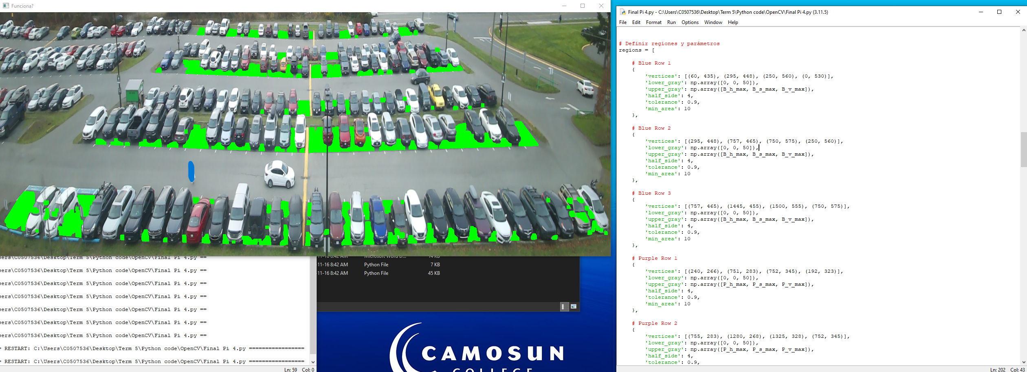
4 – Adjust filters
Set ‘half side’, ‘tolerance’ and ‘min_area’, to 4, 0.9 and 10 respectively to each region. Run the code and verify that all of the stalls’ ground possible is now green on the image.

Slide 9
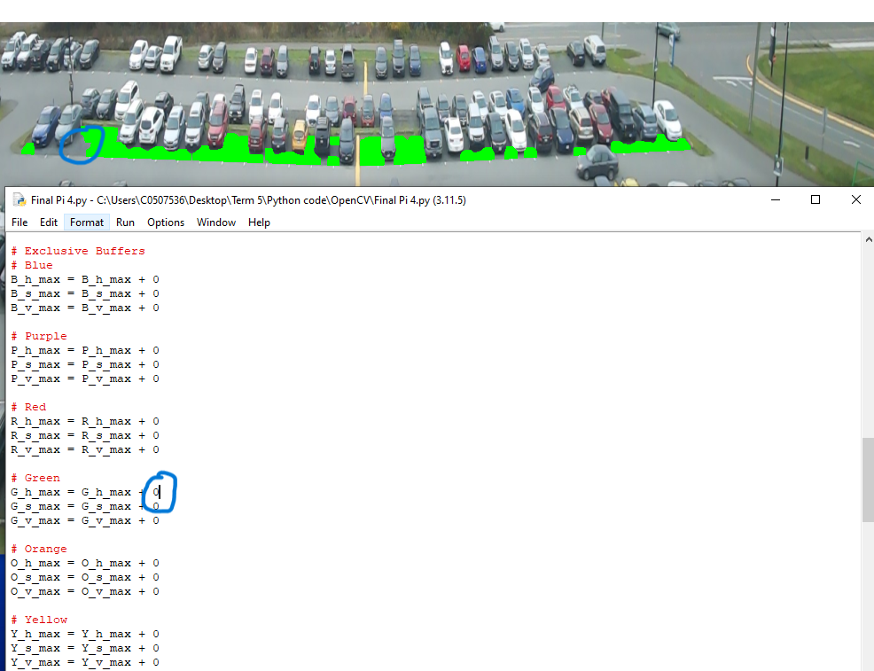
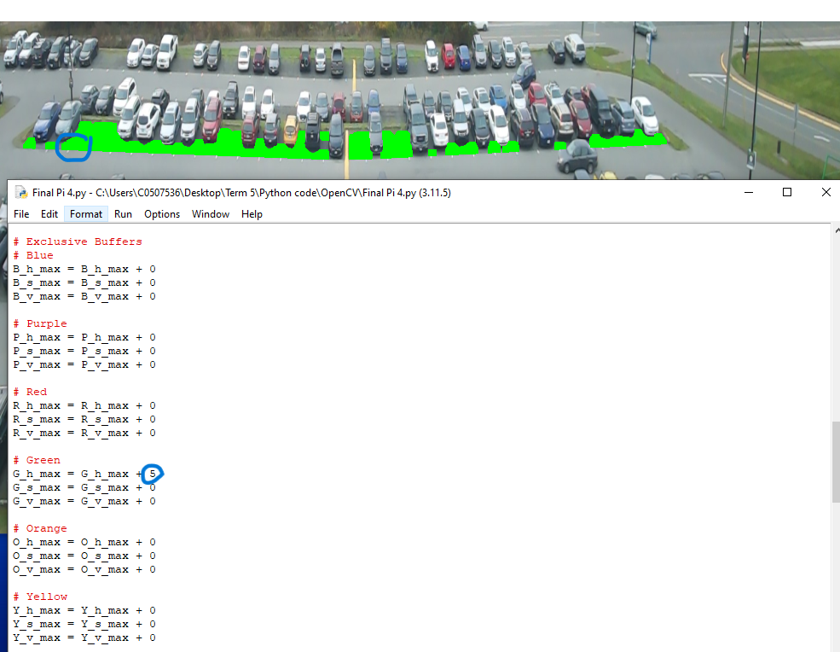
4 – Adjust filters
If you see some of the stall ground missing to be painted green, adjust the exclusive buffers to each section to compensate.

Slide 10
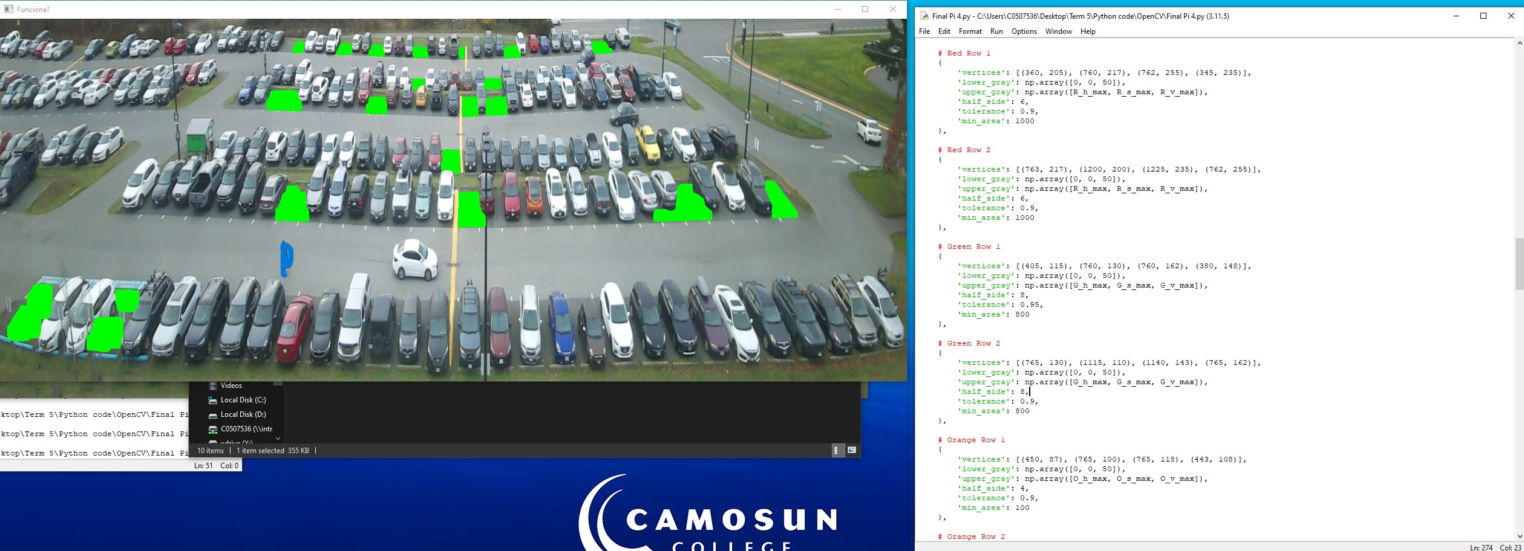
4 – Adjust filters
Adjust ‘half side’, ‘tolerance’ and ‘min_area’ to the best visual result possible, this depends on the parking lot and view conditions, here are a couple tips.
Half side: This parameter determines the dimensions of a square of green pixels, if it is set to 2 if will draw 4x4 pixels square on detected green pixel and it will overlap the pixel and compare the surrounding pixels and if the surrounding pixels are ‘green enough’ it will compact the detected pixel into a 4x4 green square of modifying the surrounding pixels. The tolerance is what determines if it is ‘green enough’ and minimum area is the total amount of green pixels in an uninterrupted region. Lower and Upper gray are defined by the HSV code gotten from the lines but could be set to fixed values (which is better for lower gray).

Slide 11
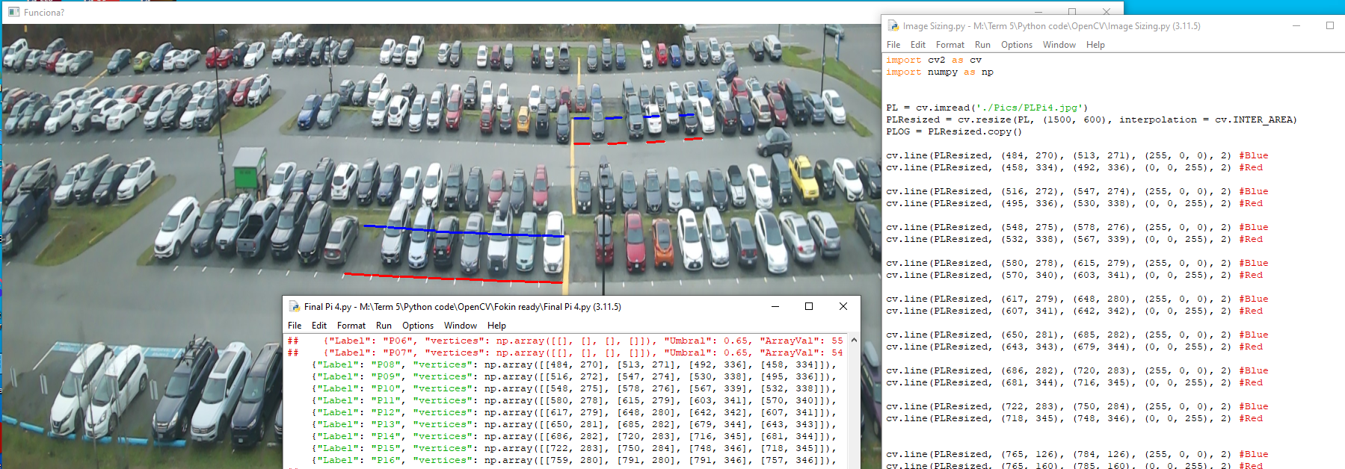
5 – Set Regions for Stalls
Using the support file, define regions for each parking stall, consider that these regions will be used to measure the amount of green pixels inside them. Note the order in which you type the vertices, the order goes from left to right: Left Upper Corner, Right Upper Corner, Right Lower Corner, Left Lower Corner.

Slide 12
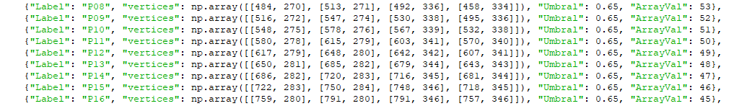
5 – Set Regions for Stalls
Modify the parameters to your needs, the labels and array values will be particular to each parking lot (Seen on another tutorial). Modify the ‘Umbral’ value for each stall to your convenience, this value is the minimum ratio of green pixels required in the region of a stall to be considered open.

Slide 13
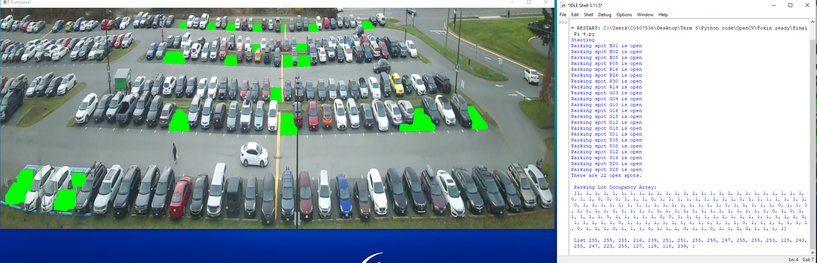
6 – Confirm accuracy
Confirm visually that the result is accurate.

Slide 14
Thank you!
Visit https://elexprep.wixsite.com/get-parked for contact information and https://github.com/Leonhardt7/Get-Parked-Leonardo-s-Detection-Code for the repository.

